Slide 1

Project Title – Superstore Data Analysis
[S I VIGNESHWAR]

Slide 2

PROBLEM STATEMENT
In today’s world, shops and online stores generate a huge amount of data, but most of the time it just sits there without being used properly. The problem is that businesses don’t always know which products are actually making them profit, where they are losing money, or how discounts are affecting their sales.
This project tries to solve that problem by analysing a superstore dataset and finding patterns in sales, profit, and customers.

Slide 3
Project Description [write detail description about your project ]
In this project, I have worked on a Superstore dataset to understand how sales and profit are distributed across different products, categories, customers, and regions.
The main steps I followed are:
Cleaning the data – removing errors, missing values, and making it ready for analysis.
Analyzing the data – checking which products sell the most, where profits come from, and how discounts impact the business.
Visualizing the results – creating simple graphs and charts to clearly show trends in sales and profit.
Finding insights – for example:
Which products or categories give more profit.
Which region performs better in sales.
Who are the top customers.
How discounts sometimes reduce profits.
The main goal of this project is to use data to tell a story about the superstore’s performance and make it easy for anyone to understand.

Slide 4

WHO ARE THE END USERS?
Shop or Business Owners
Managers
Marketing Teams
Students and Data Enthusiasts

Slide 5

Technology Used
Python
Jupyter Notebook
Pandas(Library)
Matplotlib (Library)
Dataset (Superstore Dataset – CSV file)

Slide 6
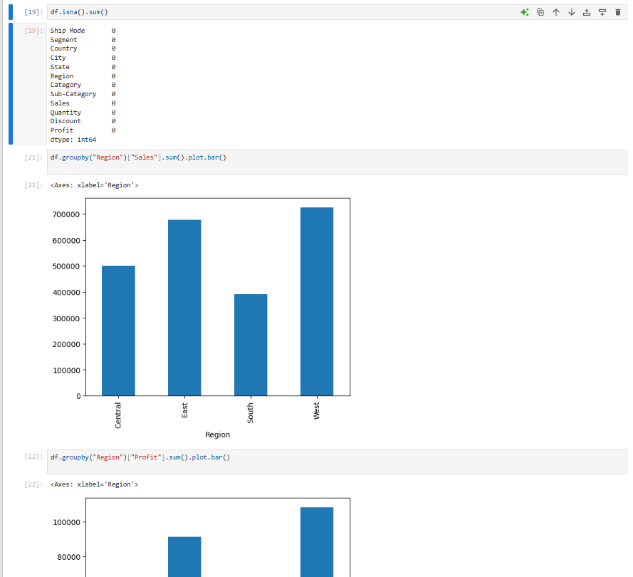
RESULTS
[Add screen shots of your code ]
Demo Link

Slide 7
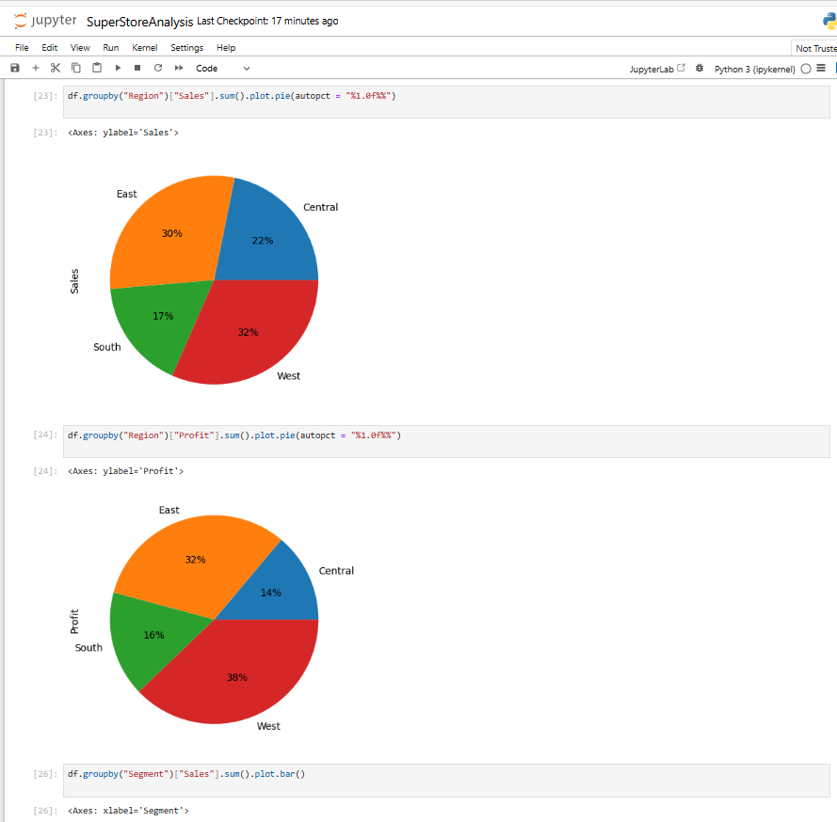
RESULTS
[Add screen shots of your code ]
Demo Link

Slide 8
Thank you
.
.

